Slide 1
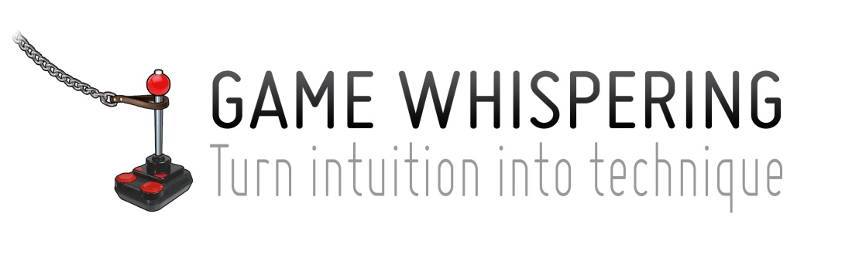
What is Game Design?

Slide 2


Who’s that guy?
14 years in the industry
Director of design (Ubisoft & Relic)
Alexandre Mandryka
Couple games I worked on

Slide 3


Slide 4

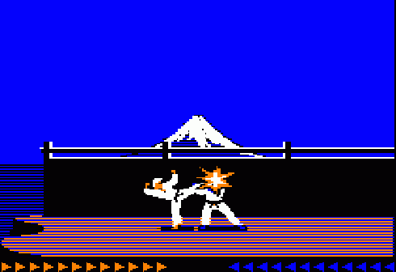
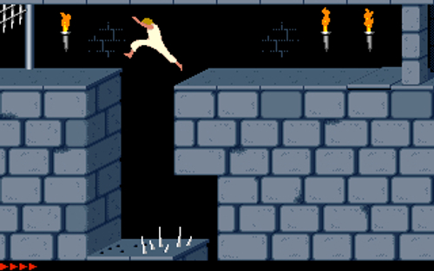
What a Game Designer was
Karateka
Prince of Persia
Jordan Mechner (80s)
Game Maker
Programming
Art
Rules
Levels

Slide 5
Game creation evolved
Game Making
Game vision
Game Maker
Programming
Art
Rules
Game design
Levels
Level design
Game design is already a huge responsibility
GD and game vision require different skills
They each need full time attention

Slide 6
Vision
Guiding principles
Guiding principles
Define your vision
Detail and expand it into concrete guiding principles that will help implementation
Support the vision with your features
Everyone is part of that process
Guiding principles
Art
Programming
Design
feature
feature
feature
feature
feature
feature
feature
feature
feature
Game

Slide 7
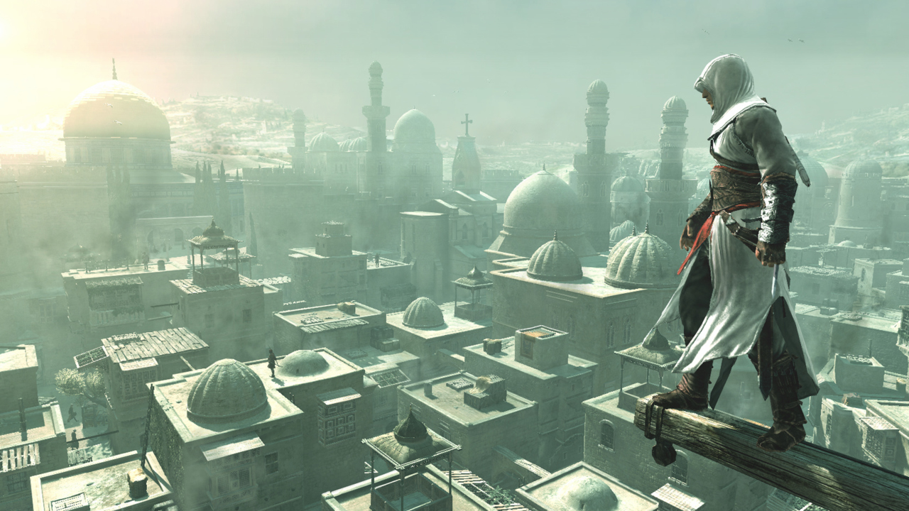

Slide 8
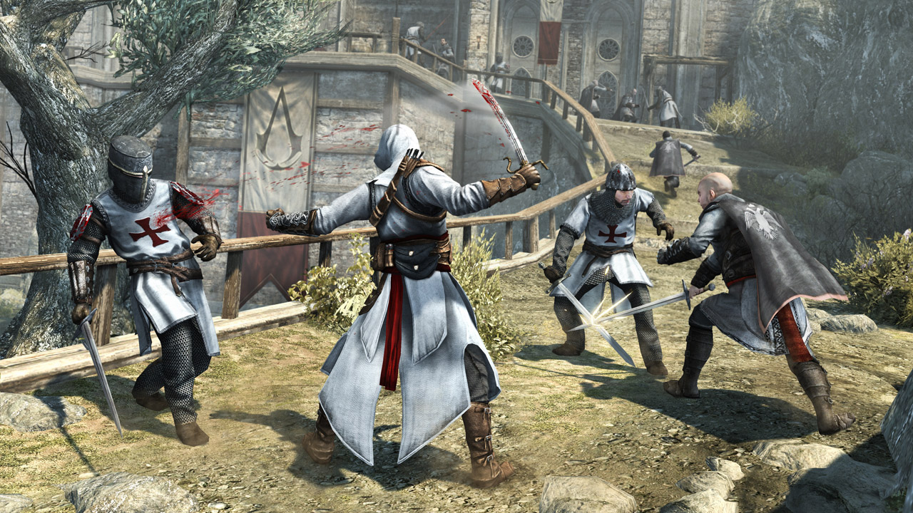

Slide 9


Slide 10


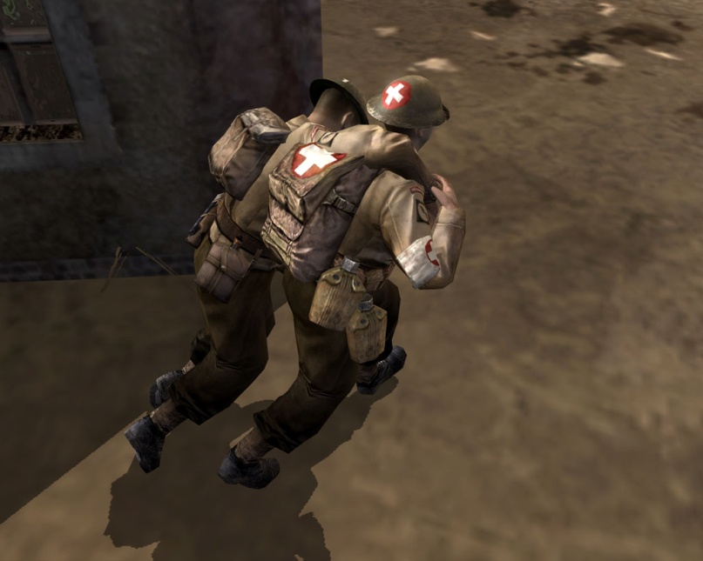
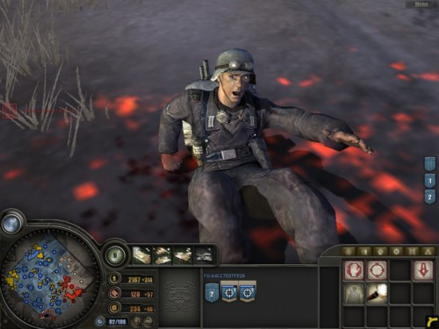

Slide 11
Skills of the trade
Know what path to take

Slide 12


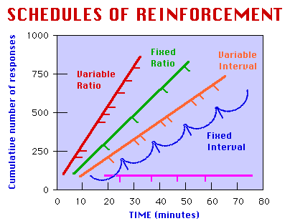
Design skills – Game Design
System design: AI, economy, game rules
Logic, mathematics, probabilities
Interaction design: Controls, interfaces, feedback
Ergonomics, biomechanics, cybernetics
Motivation design: Learning, reward, difficulty
Psychology, learning theory, motivation theory

Slide 13
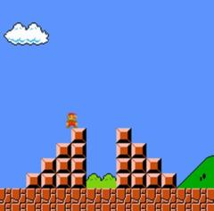
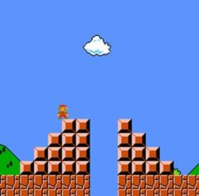

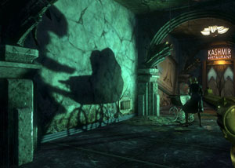
Design skills – Level Design
Gameplay implementation: Challenge creation, obstacles meet abilities
Analysis of game’s core challenge
Environment creation: Building spaces to naturally draw the player through
3D engines and tools, architecture, landscaping
Theatrics: Environmental storytelling, mood setting
Staging, cinematography techniques

Slide 14


Design skills – Narrative Design
Writing: Dialogue/screenplay, prose
Literature, creative writing
Narrative Interface Design: Designing methods to convey story to the player
Media studies, media psychology, communication
Player-Centric Plotting: Engaging the player as protagonist - Don’t tell, don’t show, let me play it!
Psychology? Literature theory?

Slide 15
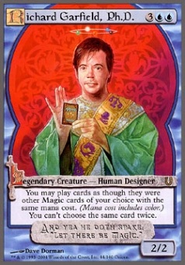


Academic background in games
Amy Jo Kim
behavioral neuroscience Ph.D.
Dr Eyjolfur Gudmundsson
Lead Economist at CCP
Ph.D.
combinatorial mathematics
Free to play monetisation – Analysts & Economists
Establishing a better metric that “Fun”
Notes:
As much as social free-to-play games have been frowned upon, they introduced some academic skills
It reduces the madness
They don’t mess around, they are all about business

Slide 16
Let’s talk about design
Blowing your mind now

Slide 17
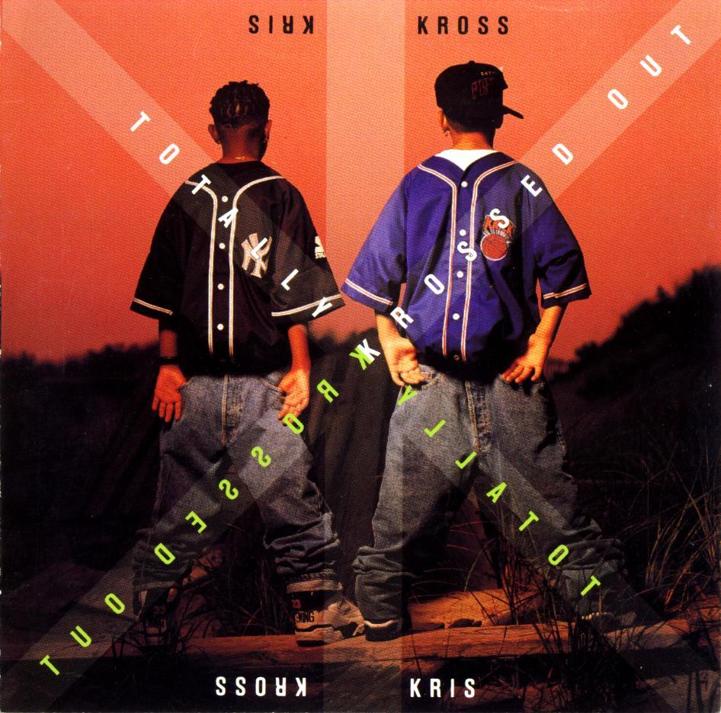
Notes:
You don’t control player behaviour, all you can do is give it a framework

Slide 18

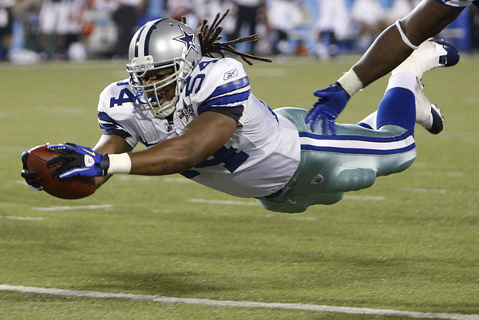

2 kinds of rules
Direct rules – How to win (Optimal strategy)
Indirect rules – Limit unwanted dominant
strategies
Touchdown: When any part of the ball, legally in possession of a player inbounds, breaks the plane of the opponent’s goal line, provided it is not a touchback.
Rested XP
Upkeep system

Slide 19
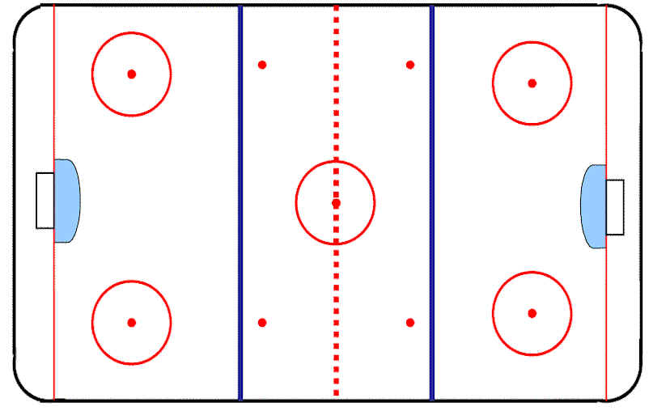
What if there’s no offside?
What is the effect on optimal strategy?

Slide 20
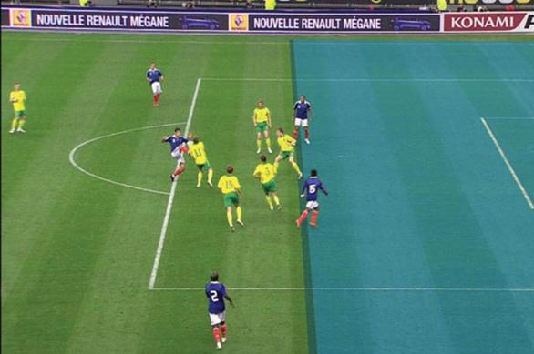
Offside
Because we want midfield play to be relevant

Slide 21

What is the effect of Offside?
Makes Hockey a contact sport

Slide 22




Intended experience
Precision
The most regular wins
Controlled risk
Sum of 4 runs

Slide 23
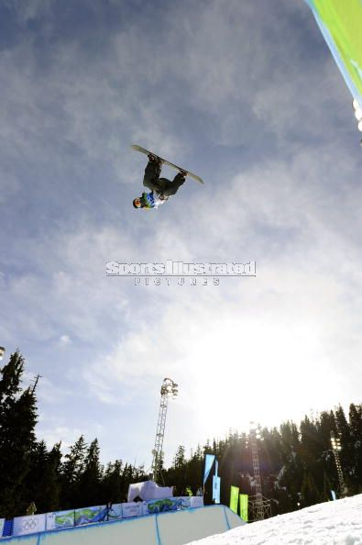
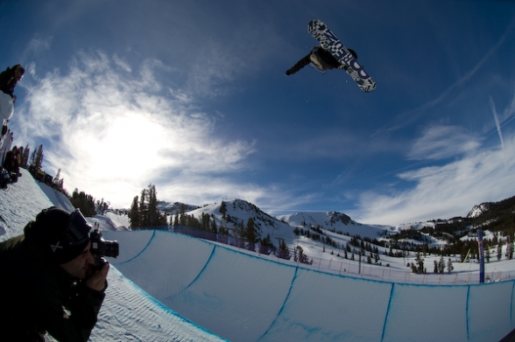
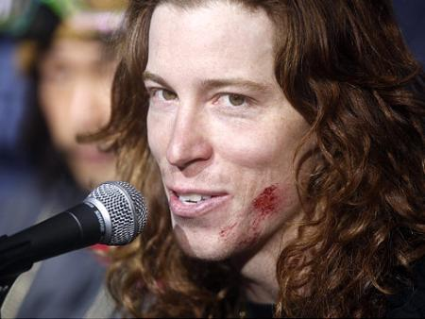
Intended experience
Fearless
The most outrageous wins
Best of 2 runs

Slide 24


Slide 25
Halo’s 30 seconds of fun
accuracy
good
Engagement
Enemy killed
average
Out of ammo
Player Choice
Reload
Melee
Grenade

Slide 26




THANK YOU!
QUICK Q&A
GameWhispering.com
/GameWhispering
/DesignBeachBum
/GameWhispering

